Slide 1
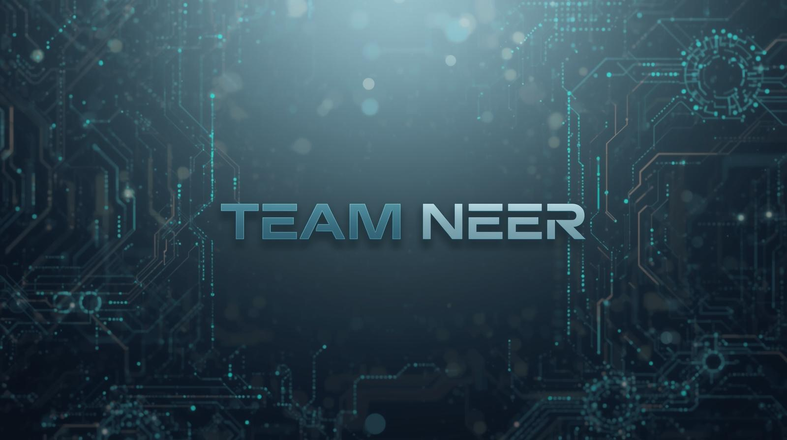
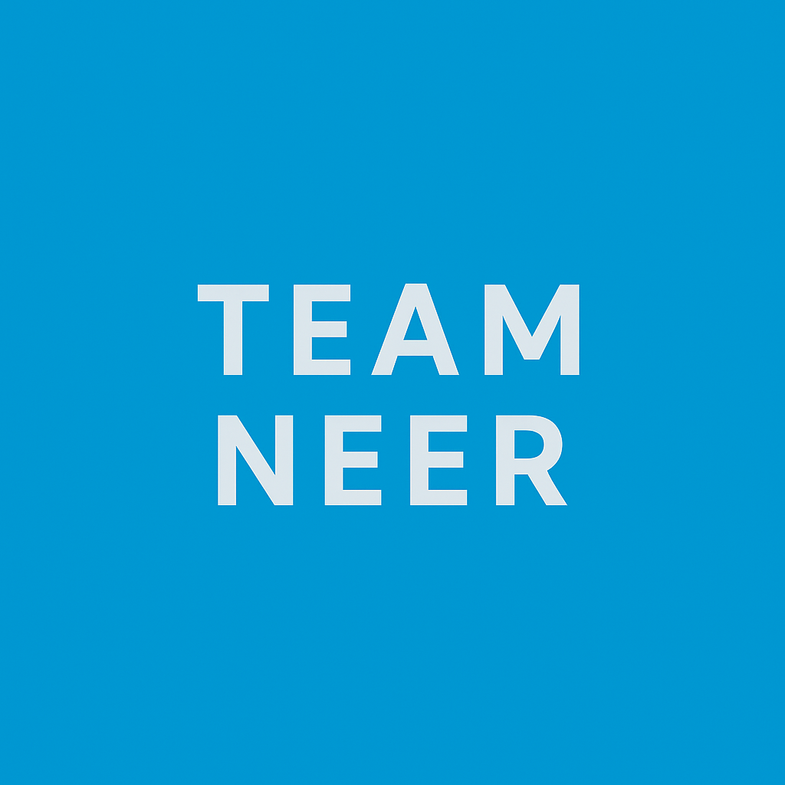
NEER: A Dual Safety Wearable Ecosystem
Two intelligent devices. One powerful platform. Purpose-built protection for women and children that understands their unique risks.

Slide 2
THE PROBLEM
Real-World Safety Gaps
Why Existing Solutions Fall Short
The Reality
One-size-fits-all approach ignores distinct risk profiles
Reactive-only systems that only work after danger strikes
Poor real-world logic that triggers too many false alarms
Women often cannot react fast during emergencies. Children can unknowingly move into unsafe zones. Current solutions fail both groups.
Different users face different dangers, yet most solutions ignore this critical distinction.

Slide 3

Our Design Philosophy
One Device Per Risk
One Clear Responsibility
Built for Real Scenarios
Each wearable addresses a specific safety challenge rather than trying to do everything
Focused functionality means faster response times and more reliable protection
Designed around how emergencies actually unfold in the real world
This focused approach delivers faster response, less confusion, and higher reliability when every second counts.

Slide 4

The NEER Ecosystem
Cloud Backend
NEER Band
Shared infrastructure and analytics
Women-focused safety device
NEER Unified Platform
Unified Mobile App
NEER Locket
Real-time alerts and controls
Child-focused safety device
Shared Infrastructure
Device-Specific Intelligence
Unified mobile app for monitoring
Cloud-based alert system
Real-time GPS tracking
Emergency contact network
Customized safety triggers per user type
Tailored alert mechanisms
Context-aware response logic
User behavior pattern analysis

Slide 5


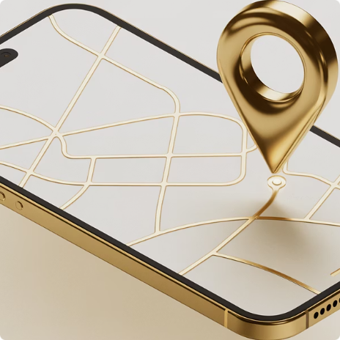
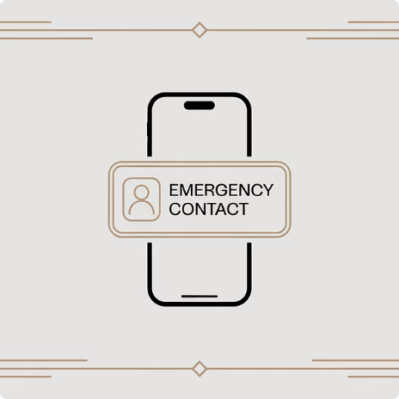

WOMEN SAFETY
NEER Band
Emergency SOS Button
Live GPS Sharing
Instant Alerts
Discreet Response
One-press activation sends immediate distress signal to all trusted contacts simultaneously
Real-time location broadcast enables rapid response and continuous tracking during emergencies
Trusted contacts receive location, timestamp, and emergency status within seconds of activation
Silent vibration mode or optional siren — user chooses the alert type based on situation

Slide 6



Smart Distress Detection
The NEER Band doesn't just wait for a button press. Advanced motion sensors and AI algorithms detect dangerous situations automatically.
Sudden Acceleration
Fall Detection
1
2
Detects forceful pulling patterns that signal dangeror rapid, involuntary movement
Identifies impact patterns and sudden drops that may indicate an attack or accident
Distress Patterns
Machine learning recognizes movement signatures associated with struggle or coercion
Critical advantage: The band can trigger alerts even when the user is unable to press SOS — providing protection when you need it most.

Slide 7





USE CASE
NEER Band in Action
Threat Detected
User feels unsafe or automatic sensors detect distress pattern
Alert Triggered
SOS activated manually or automatically by intelligent detection system
Network Notified
Emergency contacts receive live location, precise timestamp, and alert severity status
Help Arrives
Faster response time means better outcomes and increased chance of intervention
Every second matters in an emergency. NEER Band reduces critical response time through intelligent automation and instant communication.

Slide 8

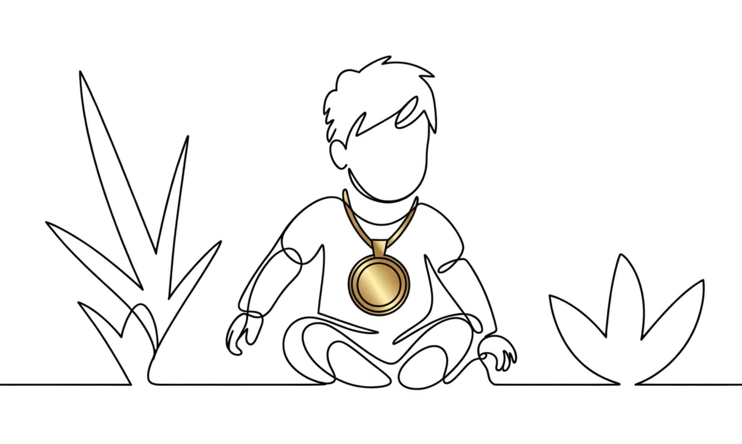
CHILD SAFETY
NEER Locket
Prevention Over Reaction
The NEER Locket stops children from unknowingly entering unsafe situations before danger occurs. Unlike reactive systems, it provides continuous protection through intelligent monitoring.
Why a Locket Form Factor?
Less intrusive than wrist-worn devices for young children
Significantly harder to accidentally remove during active play
Parent-approved design that children are comfortable wearing
Discreet protection that doesn't draw unwanted attention

Slide 9
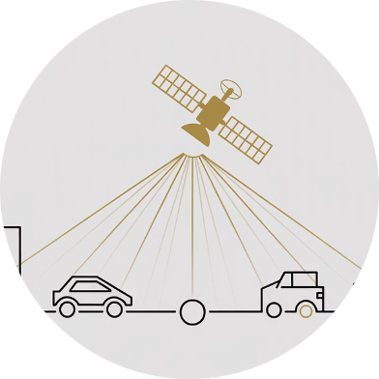
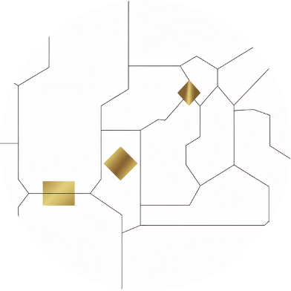
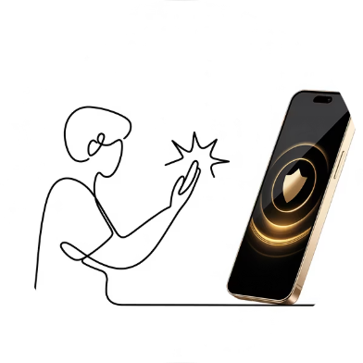

NEER Locket: Core Features
Live GPS Tracking
Intelligent Geo-Fencing
Automatic Parent Alerts
Parents can view their child's real-time location through the mobile app at any time, with location history for added peace of mind
Define safe zones like home, school, or playground. Receive instant notifications when boundaries are crossed
No action required from the child. The system monitors continuously and alerts parents to potential risks automatically
Key insight: The child doesn't need to interact with the device at all. Safety is completely automatic and invisible to the young user.

Slide 10
Intent-Aware Geofencing
This is what separates NEER from basic GPS trackers. Our system doesn't just detect boundary crossings — it understands context and intent.
Direction Analysis
Speed Detection
Temporal Context
Which way is the child moving? Toward safety or away from it?
Walking pace or running? Fast exits trigger higher priority alerts
Time of day matters. 3pm dismissal vs. 11am absence have different risk levels
Smart Scenario Example
Beyond Basic Tracking
Low Risk: Child slowly exits school at 3:15pm (normal dismissal) — no alert
This behavioral intelligence dramatically reduces false alarms while catching genuine safety concerns. Parents get meaningful alerts, not notification fatigue.
High Risk: Child rapidly exits school at 10:30am (during class hours) — immediate priority alert sent

Slide 11
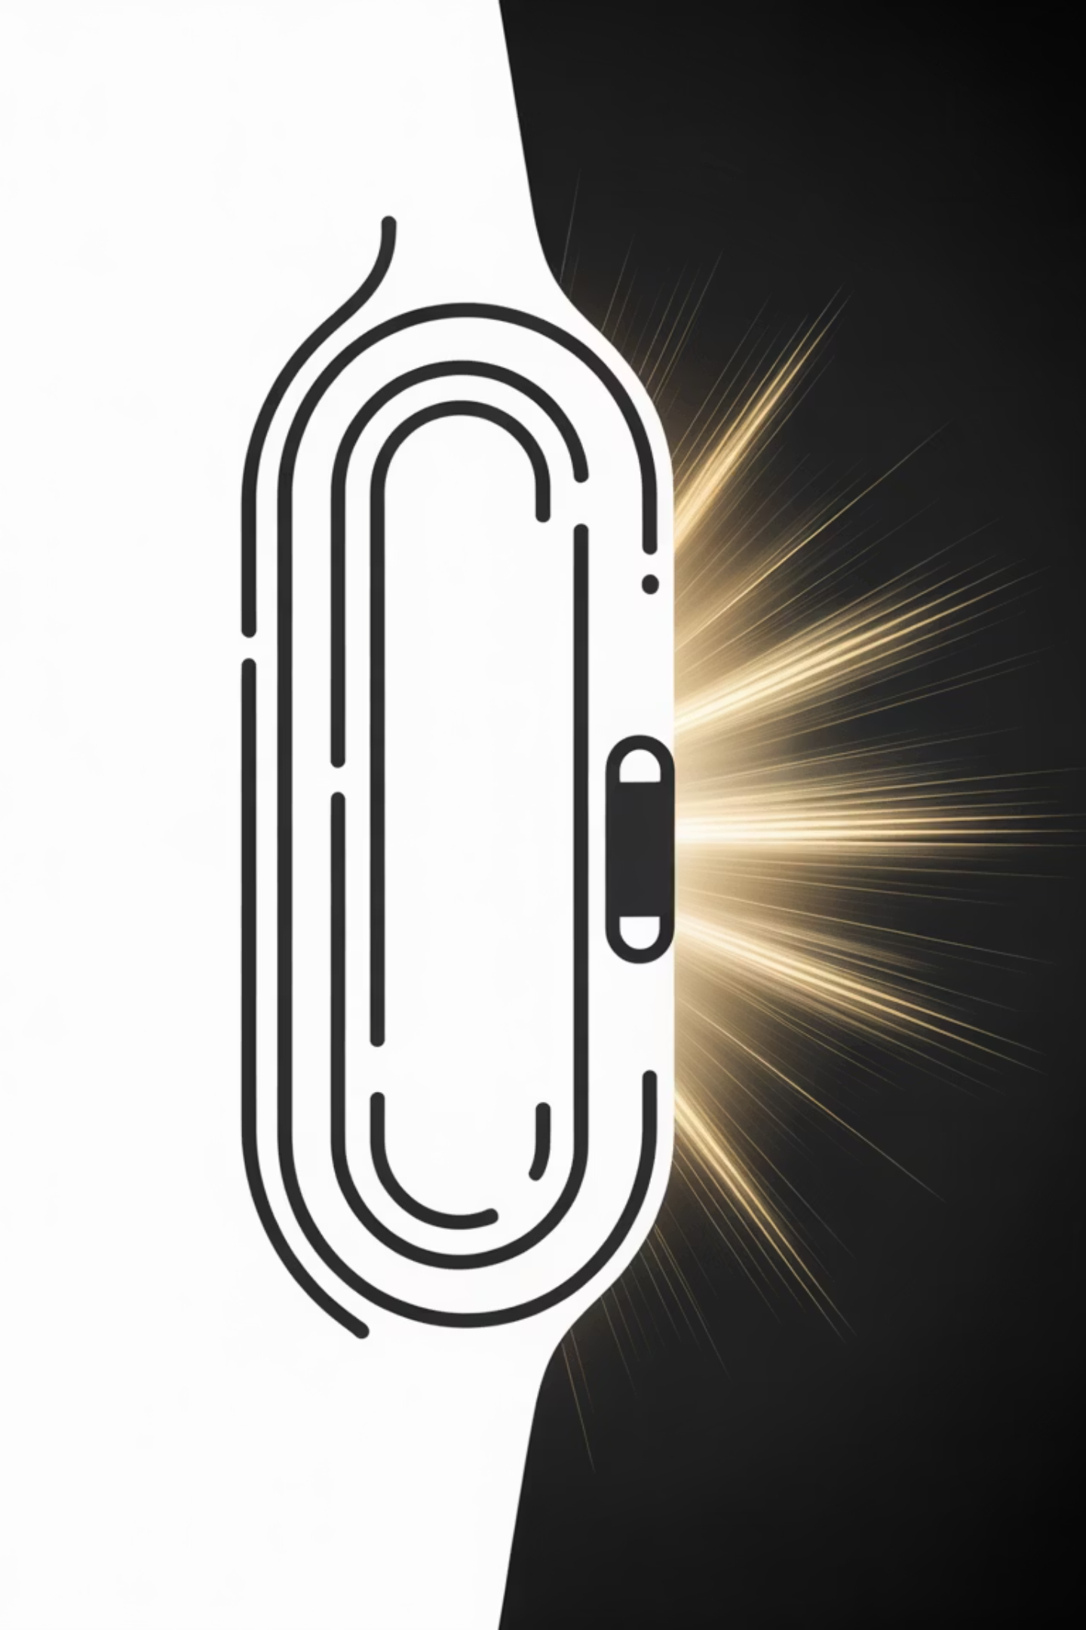
NEER Locket: Intelligent Escalation Logic
SMART SAFETY
Two-Step Alert System That Builds Trust
The Advantage
How It Works
This graduated response system dramatically reduces false alarms while maintaining vigilance. Parents stay informed without panic, building long-term trust in the device.
01
Soft Alert
Gentle notification when child exits safe boundary—non-intrusive, awareness-building
Prevents alarm fatigue from over-notification
Maintains parent confidence through accuracy
Balances awareness with peace of mind
02
Critical Alert
Escalates only if movement continues outward—urgent, action-required notification

Slide 12
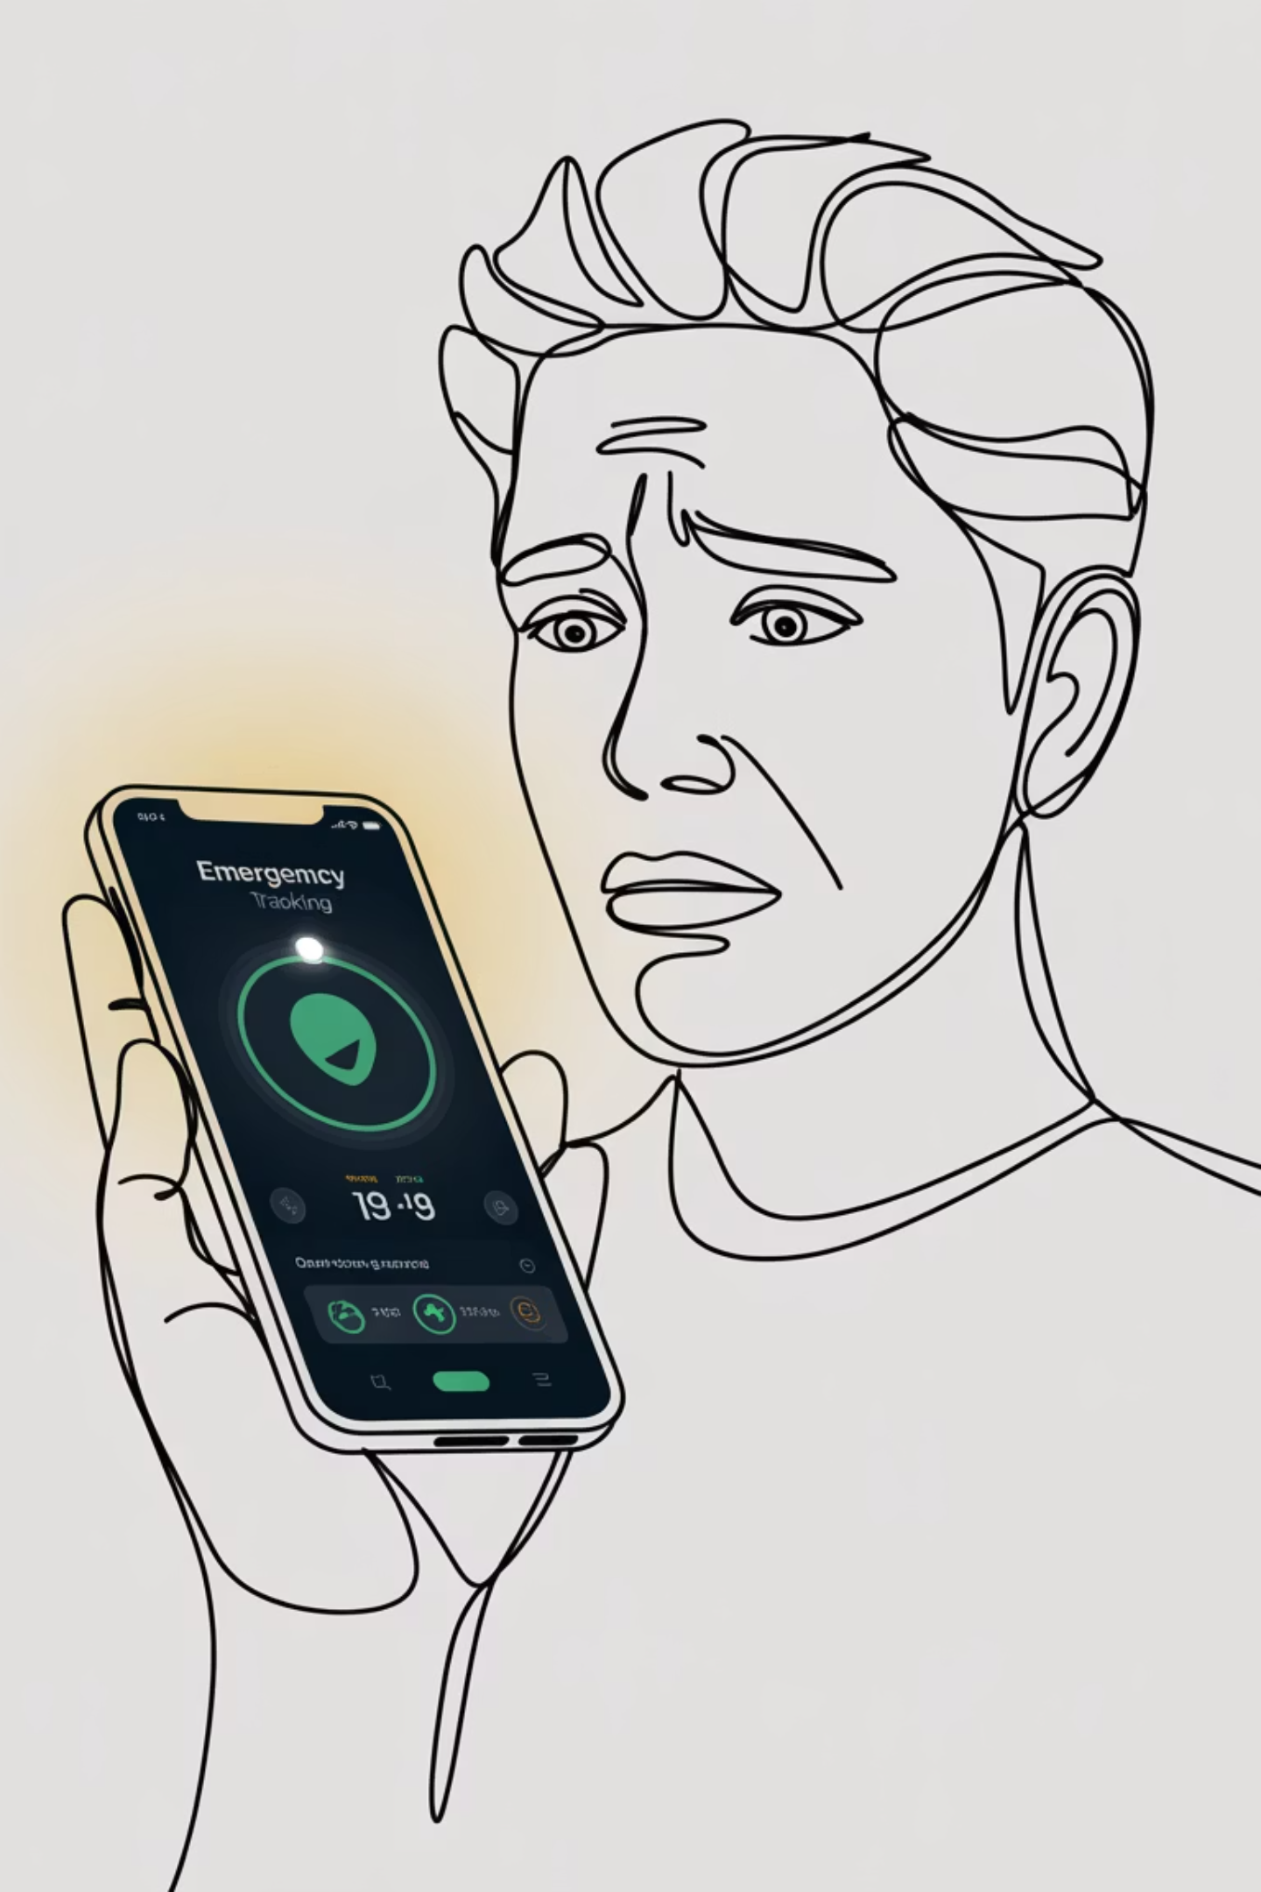







Lost-Child Mode: Emergency Response
EMERGENCY MODE
When Every Second Counts
If a parent marks their child as missing, NEER immediately shifts from passive monitoring to active emergency response. The system transforms to provide maximum support during the most critical moments.
Rapid Location Updates
Update frequency increases to near real-time intervals
Continuous Live Tracking
Persistent monitoring replaces periodic check-ins
"The locket shifts from monitoring mode to emergency mode—becoming an active safety tool, not a passive tracker."
Optional Alert Signals
Buzzer or vibration helps locate child in crowded areas
This distinction positions NEER as an intelligent, context-aware safety partner.

Slide 13

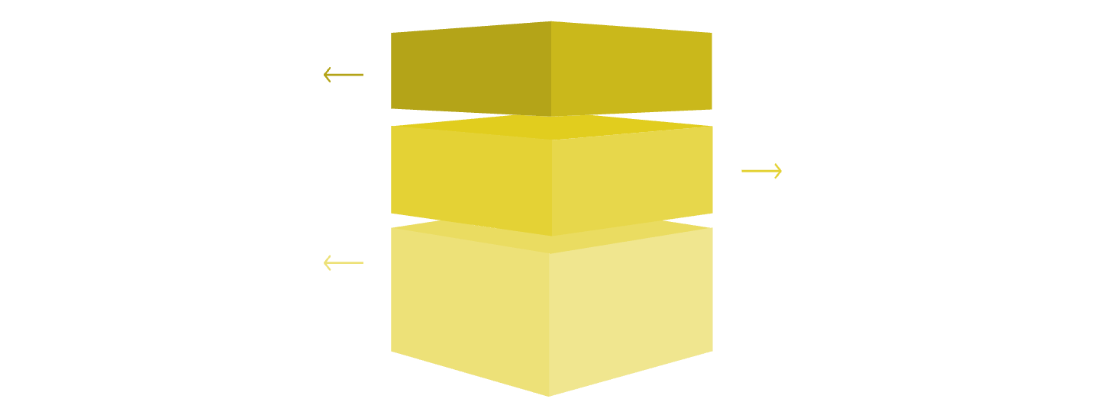

NEER System Architecture
TECHNICAL FOUNDATION
A Unified Platform with Purpose-Built Intelligence
Wearable Layer
Wearables Layer
Pendant and locket collect sensor data, GPS coordinates, and movement patterns in real-time
Collect sensor data and user vitals.
Mobile App Layer
Manage controls, local processing, and alerts.
Mobile App Layer
Handles alert notifications, user controls, boundary management, and emergency activation
Cloud Safety Layer
Apply centralized safety logic and analytics.
Cloud Intelligence
NEER's architecture enables both devices to share infrastructure while implementing device-specific safety protocols tailored to each use case.
Applies device-specific safety logic, stores historical data, and enables scalable performance
Critical distinction: Both devices use the same backend infrastructure but different safety rules—the pendant focuses on immediate threat response while the locket emphasizes boundary monitoring and escalation.

Slide 14

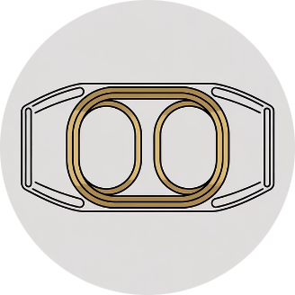

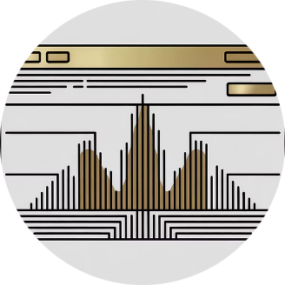

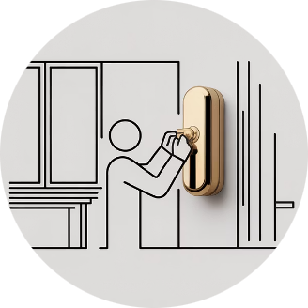
Why NEER Stands Out
COMPETITIVE EDGE
NEER combines practical engineering with user-centered design to deliver genuine safety innovation. We've built an ecosystem focused on what matters: reliable protection without complexity.
Purpose-Built Hardware
Automatic Safety Triggers
Behavior-Aware Logic
Scalable Ecosystem
Devices designed specifically for safety, not repurposed smartwatches with added features
No manual panic buttons required—intelligent detection activates protection instantly
Context-sensitive algorithms distinguish real threats from false alarms
Unified platform supports multiple devices with device-specific safety protocols
NEER delivers focused, proven
safety technology that works
when it matters most.
Real-World Practicality
Built for daily use in actual scenarios, not idealized lab conditions
Feature overload that confuses users
Exaggerated AI claims without substance

Slide 15




NEER: A Focused Safety Ecosystem
THE FUTURE OF PROTECTION
"NEER protects women through rapid emergency response and safeguards children by detecting abnormal movement before danger escalates."
Our Vision for Tomorrow
Community Alerts
Emergency Services
Predictive Intelligence
Network-based safety where nearby users can assist in emergencies
Direct integration with police, medical response, and rescue teams
Advanced pattern recognition to anticipate and prevent threats
We're building more than devices—we're creating a comprehensive safety infrastructure
that evolves with emerging threats and user needs. NEER represents the next generation
of proactive protection technology.

